Slide 1
KLE DR M S SHESHGIRI COLLEGE OF ENGG AND TECHNOLOGY, Belagavi
Department of computer science & engineering
Internship project
ONLINE MATRIMONIAL SITE
Internship Guide: Presented By:
Prof. Shashidhar Halligerimath Komal Kekare (2KL16CS039)

Slide 2
Contents
Introduction of Company
Mission Vision of Company
Internship Objective
Internship Project
Software Used
DataFlow Diagram(DFD)
Project Demo
Conclusion

Slide 3

Introduction of Company
TMITS (Technomind IT Solutions) initially was an Idea.
In the year 2013 with the efforts of the four friends lead to a real time entity forming a firm with goal to develop Business oriented software’s and train students in the global market, providing solutions in the field of business through websites, creating innovations through mobile applications.
A Group of enthusiastic members led to the startup of Technomind IT Solutions (TMITS).

Slide 4
Services offered by the company
Web development
Mobile App Development
Desktop Applications
Testing Services

Slide 5
Mission & Vision
Mission
The mission of Technomind IT solution is to continue to provide flexible and easily understandable business solutions, while optimizing advances in technology.
Vision
The objective of providing quality software products and services in various fields by harnessing the power of information technology.

Slide 6
Internship Objective
To understand the problems faced in software industry.
To go through the development cycle and models.
To create and design different websites for clients.
To have a firm understanding of programming and graphical design.

Slide 7
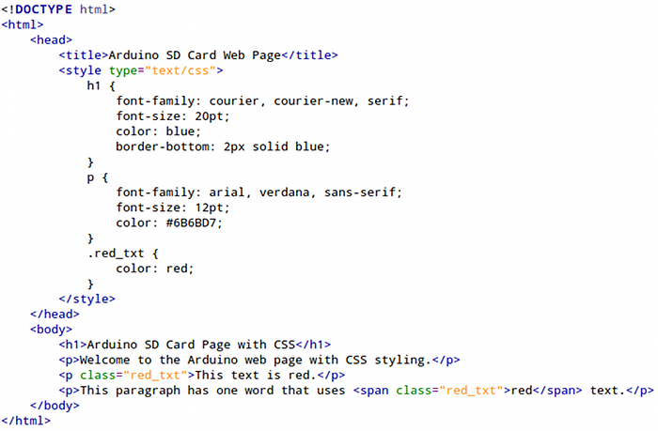
HTML5, CSS Example Code

Slide 8
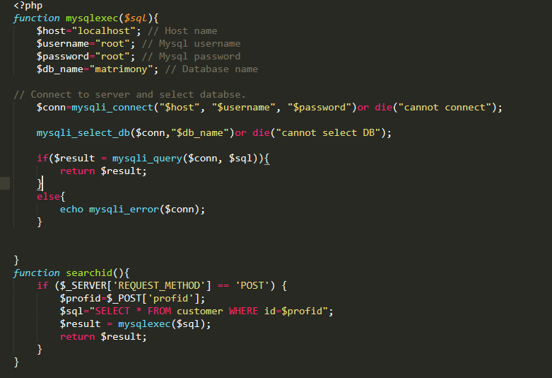
PHP Example code

Slide 9
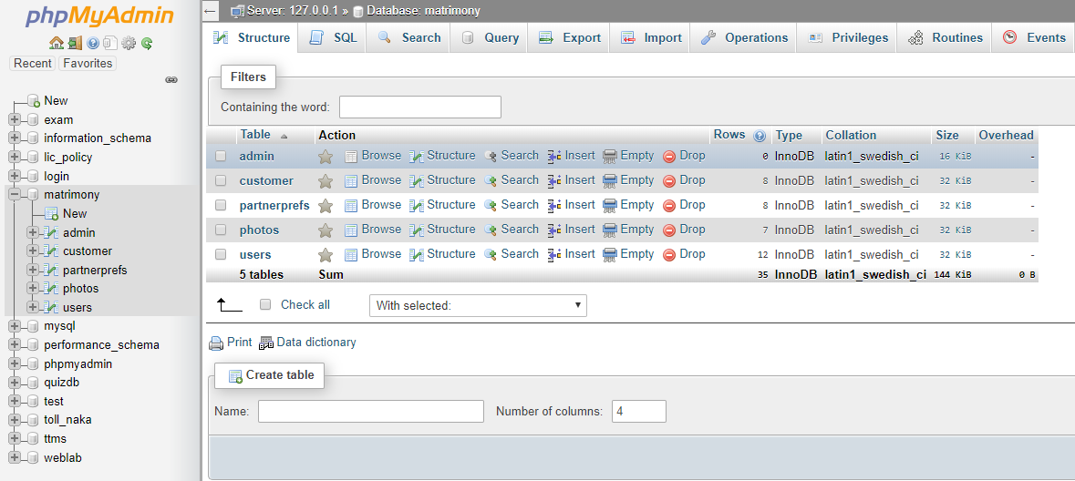
XAMPP SOFTWARE

Slide 10
Internship Project
ONLINE MATRIMONIAL SITE
Front End Coding
HTML5
CSS3
PHP
BOOTSTRAP 3 FRAMEWORK
Back End Coding
SQL

Slide 11
Required Software
Coding Editors
Sublime Text
Server
Xampp
Browser
Google Chrome
Mozilla Firefox

Slide 12
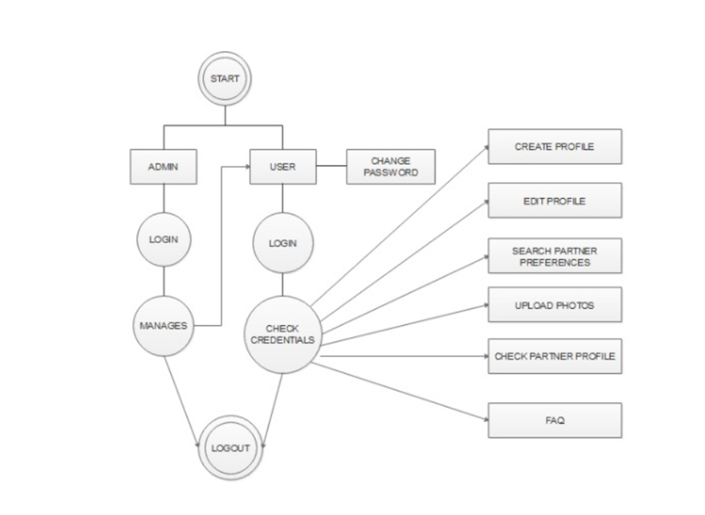
DATA FLOW DIAGRAM
MODULES USED
ADMIN
USER
PARTNER PREFERENCE
CUSTOMER
UPLOAD PHOTO

Slide 13
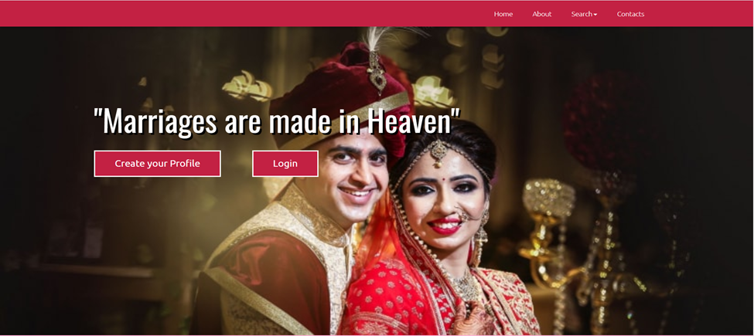
PROJECT DEMO

Slide 14
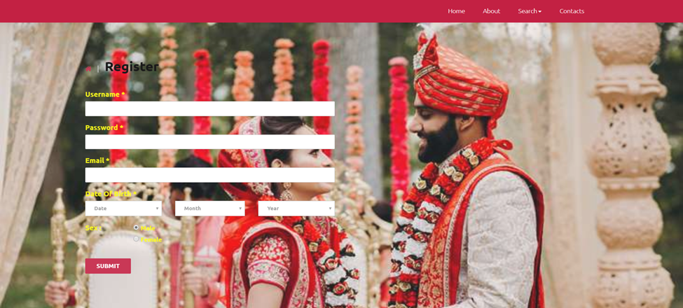
REGISTRATION PAGE

Slide 15
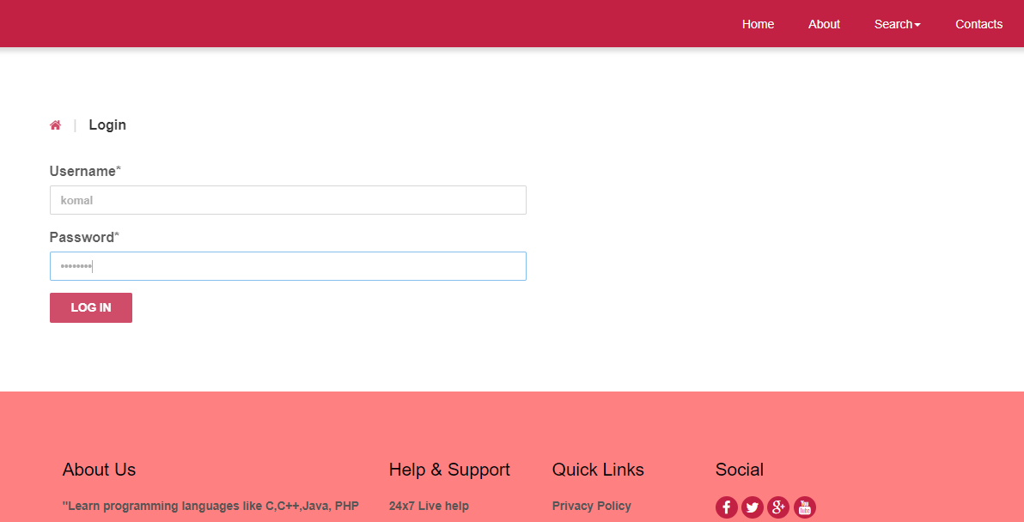
LOGIN PAGE

Slide 16
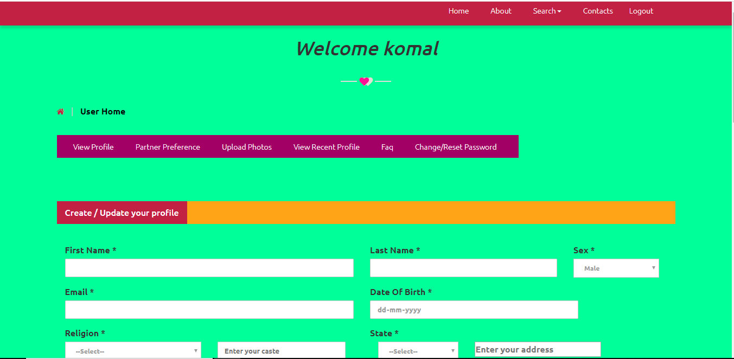
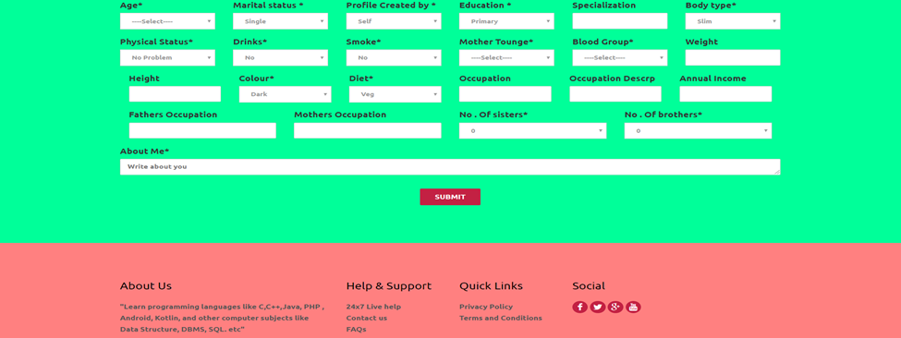
USER HOME PAGE

Slide 17
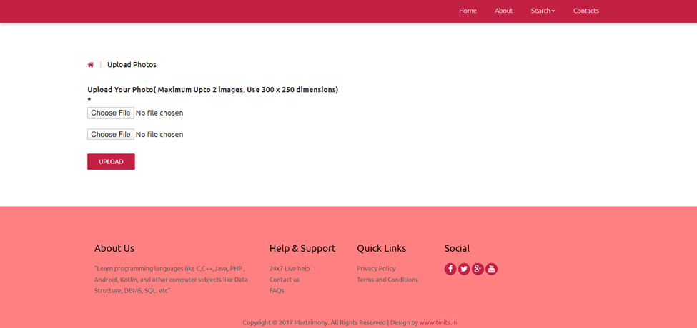
Upload Photo

Slide 18
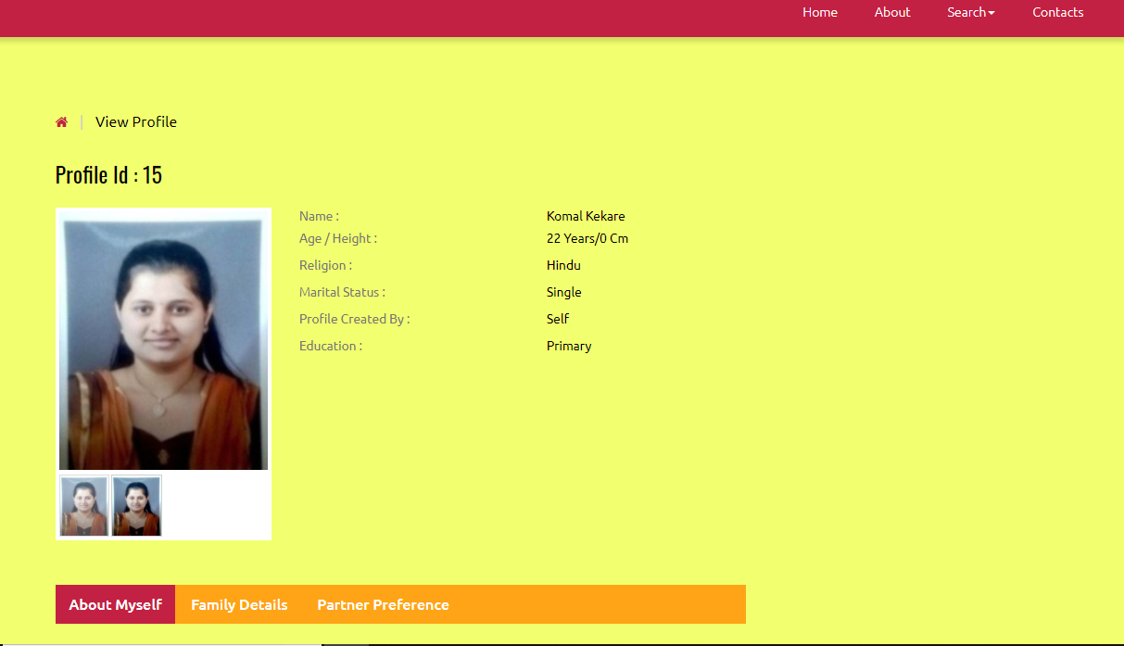
VIEW PROFILE PAGE

Slide 19
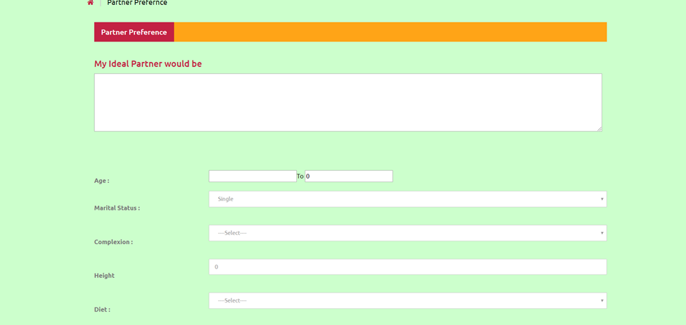
Partner preference page

Slide 20
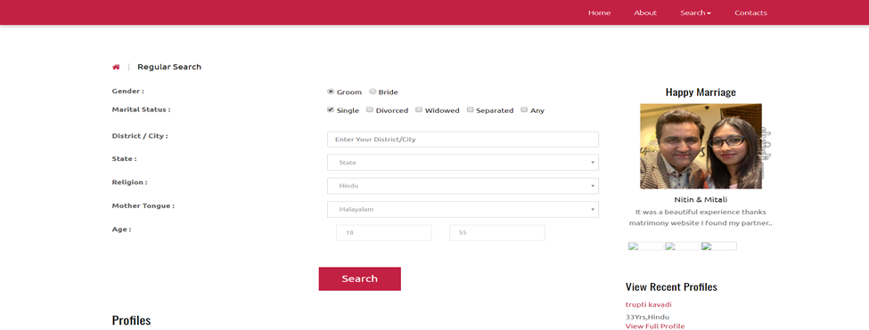
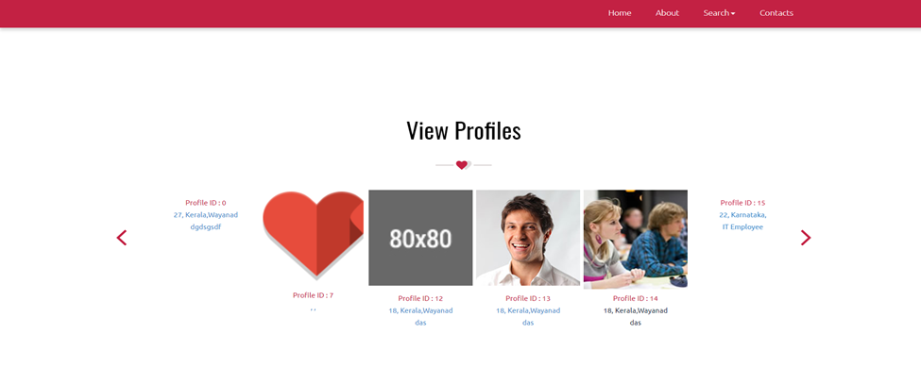
SEARCH PAGE
1. Search by Interest
2. Search by Existing Profile

Slide 21
Conclusion
Internship helps to develop our skills, abilities and knowledge.
To get exposure of company environment.
Technomind IT Solution is a good place to do the internship since it provide numerous benefits and advantages to the practical trainees.
This internship experience helps us to get practical knowledge and also helps us to develop skills to find a job later on.
Also we will get to know how to work under team environment.

Slide 22
THANK YOU

